Slide 1





Slide 2
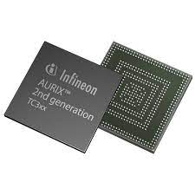

Aurix TC275 Project 1
만도 SW 3기 박중현
2023.03.24

Slide 3
목차

Slide 4
1.Infineon 마이크로컨트롤러를 사용하여 UART 통신을 구현
ㄴ

Slide 5
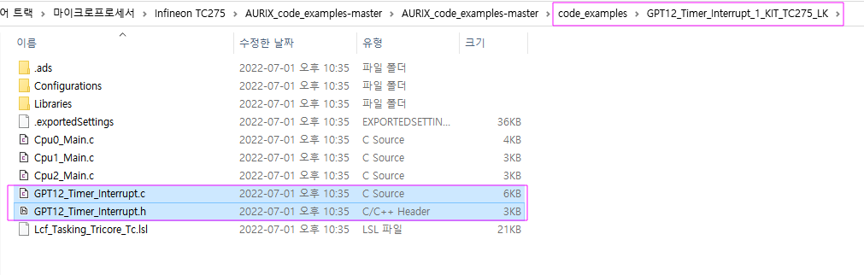
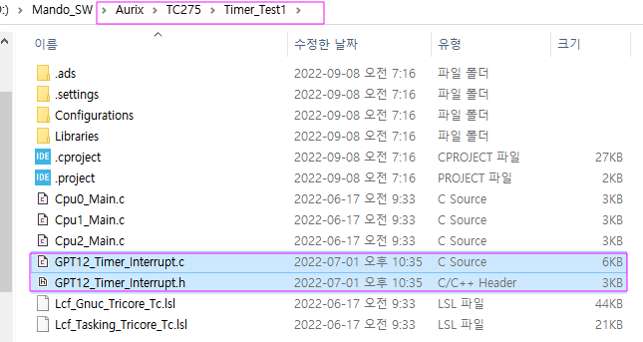
1. TC275 GPT(General Purpose Timer) 프로그래밍 이해
기존 예제 프로젝트에서 File을 복사하여 기존 프로젝터에 붙여 넣기

Slide 6
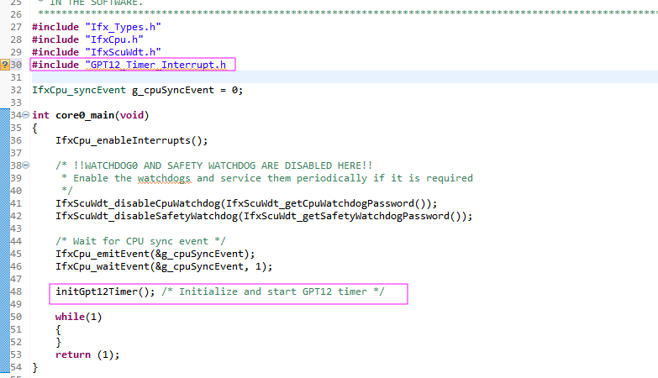
1. TC275 GPT(General Purpose Timer) 프로그래밍 이해
Cpu0_Main.c 수정
GPT12 Timer 시작

Slide 7
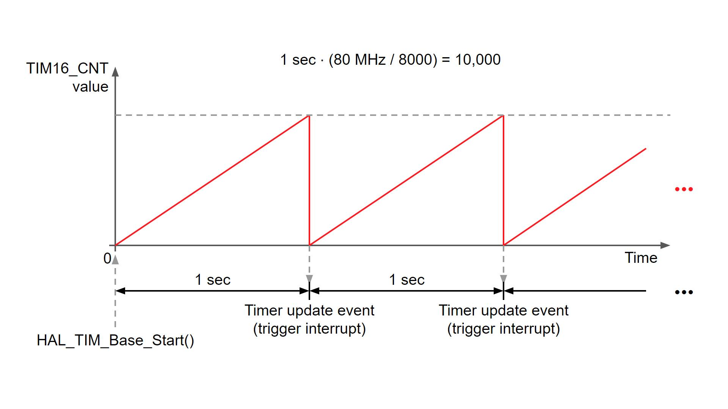
2. TC275 GPT에 대한 이해
T3
Uptimer의 경우 Overflow발생
Timer starts
Downtimer 의 경우 Underflow

Slide 8
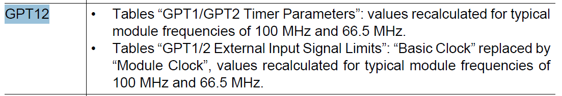
2. TC275 GPT에 대한 이해
매뉴얼 다운로드 : https://hitex.co.uk/fileadmin/uk-files/downloads/ShieldBuddy/tc27xD_um_v2.2.pdf
Generic Timer Module(GTM)의 구성 요소
- Clock Management Unit(CMU)
- Time Base Unit (TBU)
- Timer Input Module (TIM)
- Timer Output Module (TOM)
- Advanced Routing Unit(ARU) [TC275 only]
- ARU-connected Timer Output Module(ATOM) [TC275 only]
One General Purpose 12 Timer(GPT12) Unit

Slide 9
2. TC275 GPT에 대한 이해
The General Purpose Timer Unit blocks GPT1 and GPT2 have very flexible
multifunctional timer structures which may be used for timing, event counting, pulse
width measurement, pulse generation, frequency multiplication, and other purposes.
They incorporate five 16-bit timers that are grouped into the two timer blocks GPT1 and
GPT2. Each timer in each block may operate independently in a number of different
modes such as Gated Timer or Counter Mode, or may be concatenated with another
timer of the same block.

Slide 10
2. TC275 GPT에 대한 이해
Block GPT1 contains three timers/counters: The core timer T3 and the two auxiliary
timers T2 and T4. The maximum resolution is fGPT/4. The auxiliary timers of GPT1 may
optionally be configured as reload or capture registers for the core timer. These registers
are listed in Section 27.1.6.1.
The following list summarizes the supported features:
• fGPT/4 maximum resolution
• 3 independent timers/counters
• Timers/counters can be concatenated
• 4 operating modes:
– Timer Mode
– Gated Timer Mode
– Counter Mode
– Incremental Interface Mode
• Reload and Capture functionality
• Separate interrupts

Slide 11
2. TC275 GPT에 대한 이해
Block GPT2 contains two timers/counters: The core timer T6 and the auxiliary timer T5.
The maximum resolution is fGPT/2. An additional Capture/Reload register (CAPREL)
supports capture and reload operation with extended functionality. These registers are
listed in Section 27.2.7.1.
The following list summarizes the supported features:
• fGPT/2 maximum resolution
• 2 independent timers/counters
• Timers/counters can be concatenated
• 3 operating modes:
– Timer Mode
– Gated Timer Mode
– Counter Mode
• Extended capture/reload functions via 16-bit capture/reload register CAPREL
• Separate interrupts

Slide 12
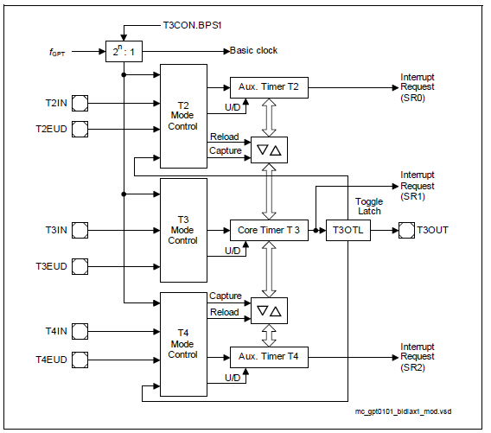
2. TC275 GPT에 대한 이해

Slide 13
2. TC275 GPT에 대한 이해
GPT1 Core Timer T3 Control
The current contents of the core timer T3 are reflected by its count register T3. This
register can also be written to by the CPU, for example, to set the initial start value.
The core timer T3 is configured and controlled via its control register T3CON.
Timer T3 Run Control
The core timer T3 can be started or stopped by software through bit T3R (Timer T3 Run
Bit). This bit is relevant in all operating modes of T3. Setting bit T3R will start the timer,
clearing bit T3R stops the timer.
In Gated Timer Mode, the timer will only run if T3R = 1 and the gate is active (high or low,
as programmed).
Note: When bit T2RC or T4RC in timer control register T2CON or T4CON is set, bit T3R
will also control (start and stop) the auxiliary timer(s) T2 and/or T4.
Count Direction Control
The count direction of the GPT1 timers (core timer and auxiliary timers) can be controlled
either by software or by the external input pin TxEUD (Timer Tx External Up/Down
Control Input). These options are selected by bits TxUD and TxUDE in the respective
control register TxCON. When the up/down control is provided by software (bit
TxUDE = 0), the count direction can be altered by setting or clearing bit TxUD. When bit
TxUDE = 1, pin TxEUD is selected to be the controlling source of the count direction.
However, bit TxUD can still be used to reverse the actual count direction, as shown in
Table 27-6. The count direction can be changed regardless of whether or not the timer
is running.

Slide 14
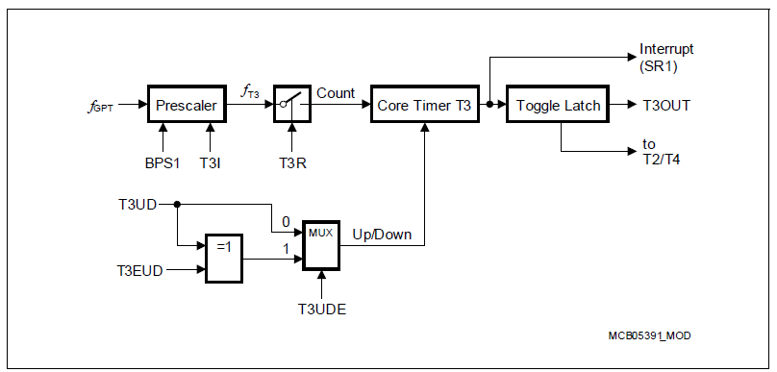
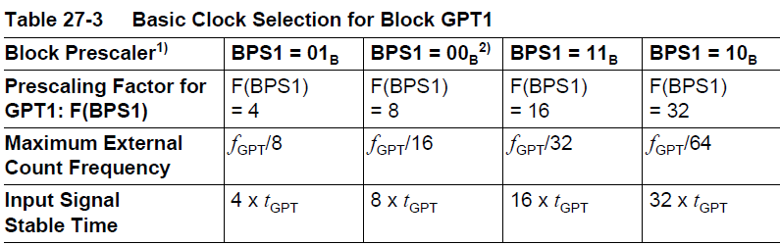
2. TC275 GPT에 대한 이해
GPT1 Core Timer T3 Operating Modes
Timer Mode for the core timer T3 is selected by setting bitfield T3M in register T3CON
to 000B. In Timer Mode, T3 is clocked with the module’s input clock fGPT divided by two
programmable prescalers controlled by bitfields BPS1 and T3I in register T3CON.
Please see Section 27.1.5 for details on the input clock options.
매우 빠른 cpu clock을 줄여서 timer/counter에 입력

Slide 15
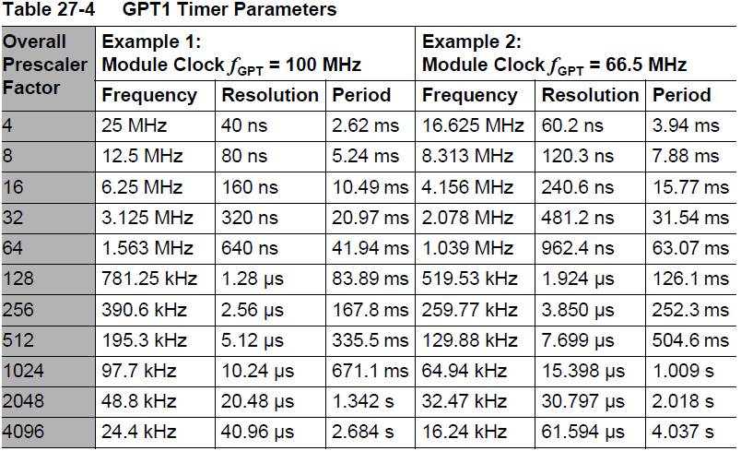
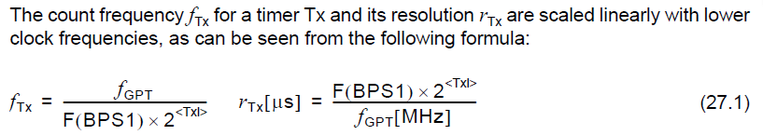
2. TC275 GPT에 대한 이해

Slide 16
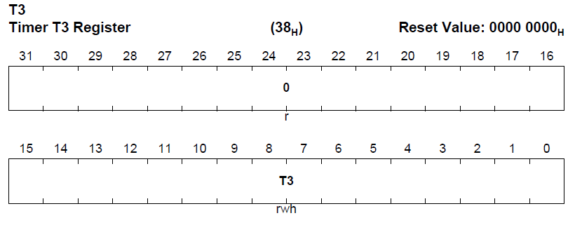
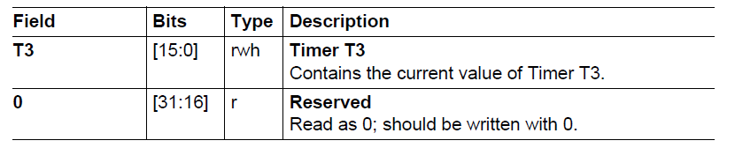
2. TC275 GPT에 대한 이해
Timer Register
16bits Timer

Slide 17
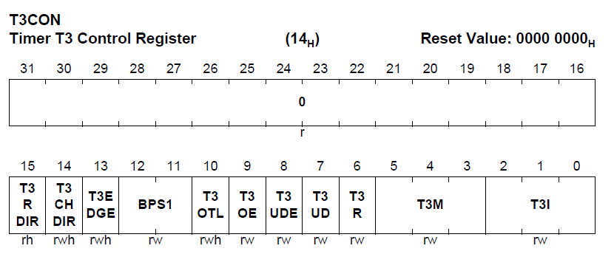
2. TC275 GPT에 대한 이해
GPT1 Core Timer T3 Control Register

Slide 18
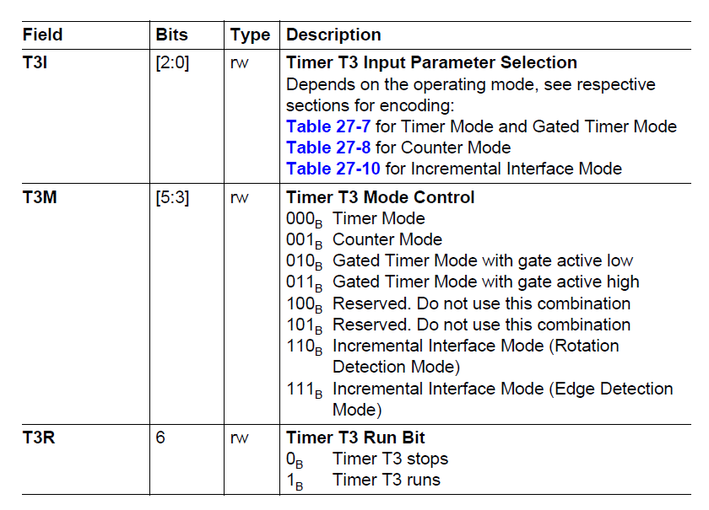
2. TC275 GPT에 대한 이해
GPT1 Core Timer T3 Control Register
Timer를 source 입력 방식
Timer를 동작 방식
Timer를 동작 하고 멈추는 비트

Slide 19
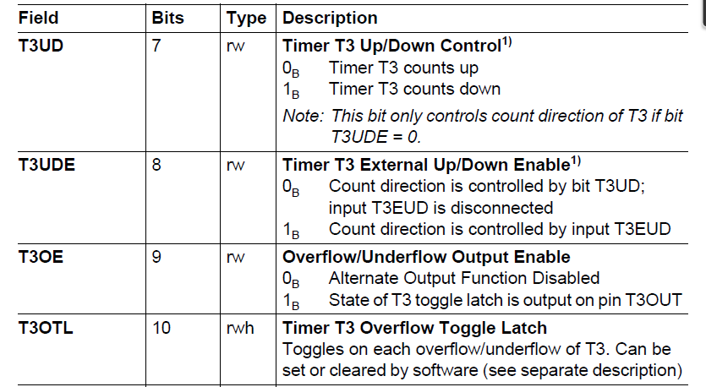
2. TC275 GPT에 대한 이해
GPT1 Core Timer T3 Control Register

Slide 20
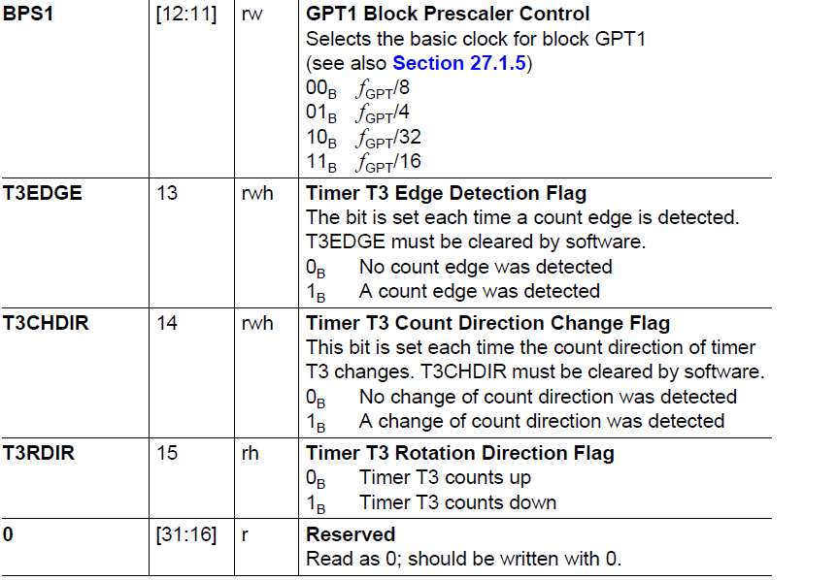
2. TC275 GPT에 대한 이해
GPT1 Core Timer T3 Control Register

Slide 21
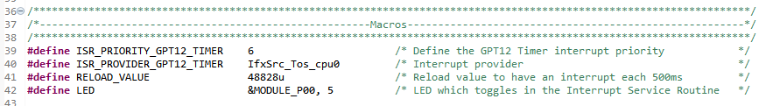
3. TC275 GPT 예제 프로그램 소스 이해
GPT12_Timer_Interrupt.c 분석
Timer start 값

Slide 22
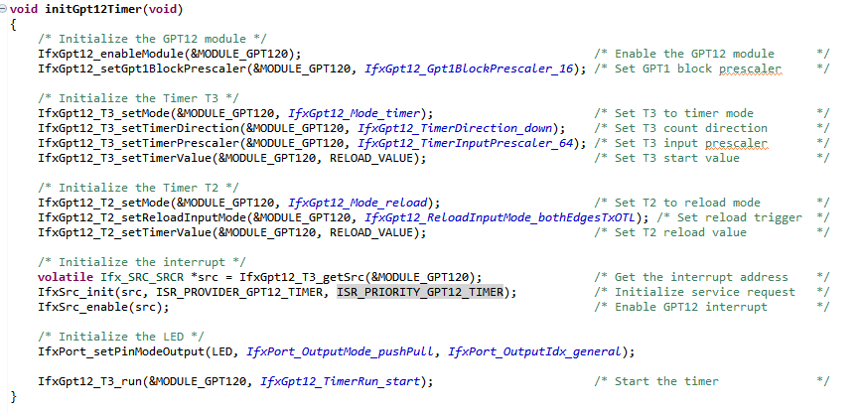
3. TC275 GPT 예제 프로그램 소스 이해
GPT12_Timer_Interrupt.c 분석

Slide 23
3. TC275 GPT 예제 프로그램 소스 이해
GPT12_Timer_Interrupt.c 분석
Resolution = 160ns

Slide 24

3. TC275 GPT 예제 프로그램 소스 이해
GPT12_Timer_Interrupt.c 분석
Down count
6.25MHz Resolution = 160ns 을 다시 64 로 나눔
10.24us x 48828 = 499998.7us = 499.9987ms

Slide 25
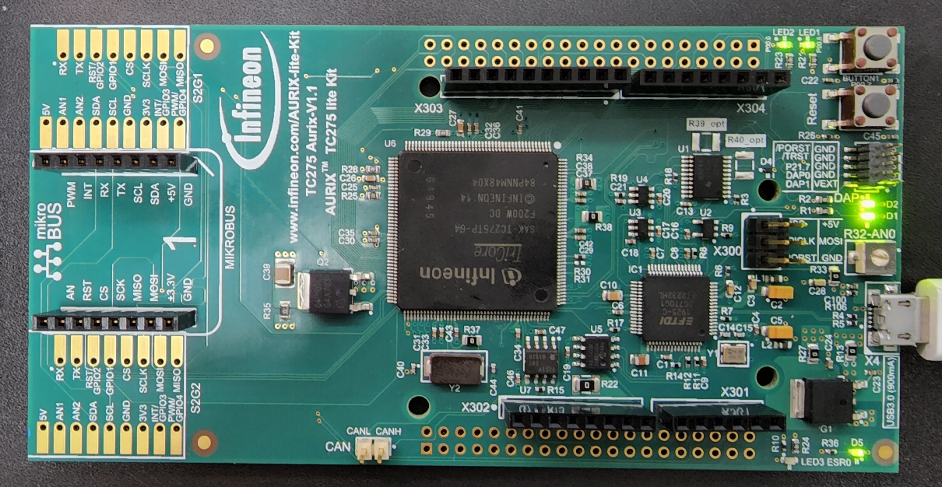
3. TC275 GPT 예제 프로그램 소스 이해
GPT12_Timer_Interrupt.c 동작 – build 후 debug 실행
ㅍ
LED 점등이 됨 500msec

Slide 26
4. TC275 GPT 예제 프로그램 소스 응용
1) Timer3의 작동 시간 변경 500ms-> 100msc
2) Timer3의 LED 10번 작동 후에 정지
timer interrupt 활용 - > 변수 정해서 10번이 되면 stop하기
IfxGpt12_T3_run(&MODULE_GPT120, IfxGpt12_TimerRun_start); 를 stop으로 바꾸기
IFX_INLINE void IfxGpt12_T3_run(Ifx_GPT12 *gpt12, IfxGpt12_TimerRun runTimer)
{
gpt12->T3CON.B.T3R = runTimer;
}
3) Timer3의 down timer에서 uptimer로 변경

Slide 27
5. TC275 GPT Timer 프로그램 응용-2
Interrupt routine에 IO 연결 및 count 연결
/* Interrupt Service Routine of the GPT12 */
void interruptGpt12(void)
{
// IfxGpt12_T3_setTimerValue(&MODULE_GPT120, RELOAD_VALUE/10); /* Set T3 start value */
//IfxPort_togglePin(LED1); /* Toggle LED state */
//IfxPort_togglePin(TEST_PIN1); /* Toggle LED state */
IfxPort_setPinLow(TEST_PIN1);
IfxPort_setPinHigh(TEST_PIN1);
if(t3_cnt == 3)
{
IfxGpt12_T3_run(&MODULE_GPT120, IfxGpt12_TimerRun_stop);
t3_cnt = -1;
}
waitTime(IfxStm_getTicksFromMilliseconds(BSP_DEFAULT_TIMER, WAIT_TIME)); // 1msec 지연 루틴
IfxPort_setPinLow(TEST_PIN1);
// t3_cnt++;
}

Slide 28
5. TC275 GPT Timer 프로그램 응용
실행결과 10 msec 타이머

Slide 29
5. TC275 GPT Timer 프로그램 응용-2
#define WAIT_TIME 1 /* 1msec */
/* Interrupt Service Routine of the GPT12 */
void interruptGpt12(void)
{
// IfxGpt12_T3_setTimerValue(&MODULE_GPT120, RELOAD_VALUE/10); /* Set T3 start value */
//IfxPort_togglePin(LED1); /* Toggle LED state */
//IfxPort_togglePin(TEST_PIN1); /* Toggle LED state */
IfxPort_setPinLow(TEST_PIN1);
IfxPort_setPinHigh(TEST_PIN1);
if(t3_cnt == 3)
{
IfxGpt12_T3_run(&MODULE_GPT120, IfxGpt12_TimerRun_stop);
t3_cnt = -1;
}
waitTime(IfxStm_getTicksFromMilliseconds(BSP_DEFAULT_TIMER, WAIT_TIME));
IfxPort_setPinLow(TEST_PIN1);
t3_cnt++; // 주석해제
}

Slide 30
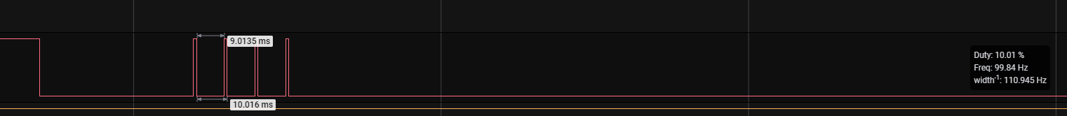
5. TC275 GPT Timer 프로그램 응용-2
실행결과 10 msec 타이머 4번(0~3) 발생 후 정지

Slide 31
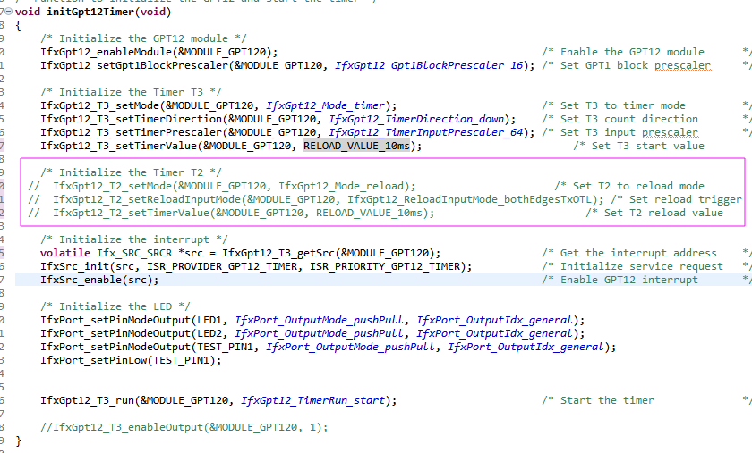
5. TC275 GPT Timer 프로그램 응용-3
Auxiliary Timer 작동 중지

Slide 32
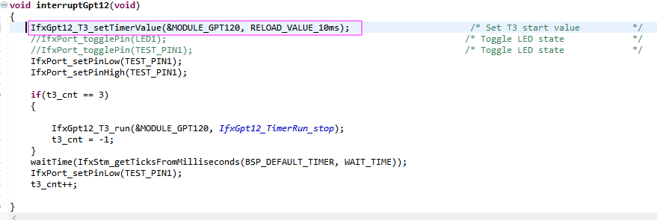
5. TC275 GPT Timer 프로그램 응용-3
보조타이머 작동 중지하고 T3 underflow interrupt 발생시 T3 count reload

Slide 33
5. TC275 GPT Timer 프로그램 응용-3
실행결과 10 msec 타이머 4번(0~3) 발생 후 정지
T3 underflow로 인한 interrupt 발생

Slide 34
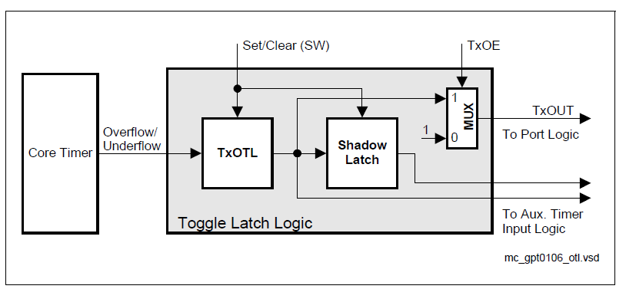
6. TC275 GPT 예제 프로그램 소스 이해
Timer T3 Output Toggle Latch

Slide 35
6. TC275 GPT 예제 프로그램 소스 이해
GPT12_Timer_Interrupt.c 분석
보조 타이머인 Timer2 사용
GPT1 Auxiliary Timers T2/T4 Control
Auxiliary timers T2 and T4 have exactly the same functionality. They can be configured
for Timer Mode, Gated Timer Mode, Counter Mode, or Incremental Interface Mode with
the same options for the timer frequencies and the count signal as the core timer T3. In
addition to these 4 counting modes, the auxiliary timers can be concatenated with the
core timer, or they may be used as reload or capture registers in conjunction with the
core timer. The start/stop function of the auxiliary timers can be remotely controlled by
the T3 run control bit. Several timers may thus be controlled synchronously.

Slide 36
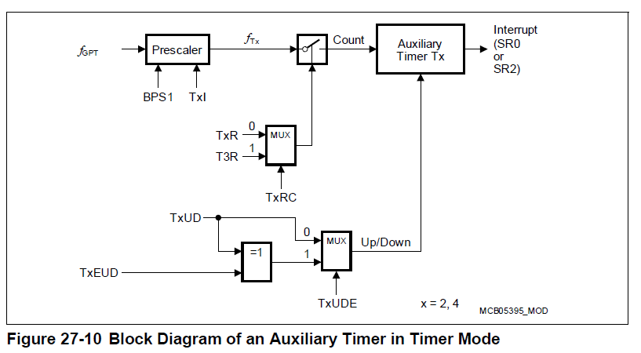
6. TC275 GPT 예제 프로그램 소스 이해
GPT12_Timer_Interrupt.c 분석

Slide 37
6. TC275 GPT 예제 프로그램 소스 이해
Timers T2 and T4 in Reload Mode
Reload Mode for an auxiliary timer Tx is selected by setting bitfield TxM in the respective
register TxCON to 100B.
In Reload Mode, the core timer T3 is reloaded with the contents
of an auxiliary timer register, triggered by one of two different signals. The trigger signal
is selected the same way as the clock source for Counter Mode (see Table 27-9), i.e. a
transition of the auxiliary timer’s input TxIN or the toggle latch T3OTL may trigger the
reload.
Note: When programmed for Reload Mode, the respective auxiliary timer (T2 or T4)
stops independently of its run flag T2R or T4R.
The timer input pin TxIN must be configured as input if it shall trigger a reload
operation.

Slide 38
7. TC275 GPT 예제 프로그램 소스 이해
T2 Reload
다시 Timer2 reload
Timer3 Interrupt발생
Timer2 T2 값 reload
T2= RELOAD_VALUE_10ms
Timer3(2) interrupt발생
T3

Slide 39
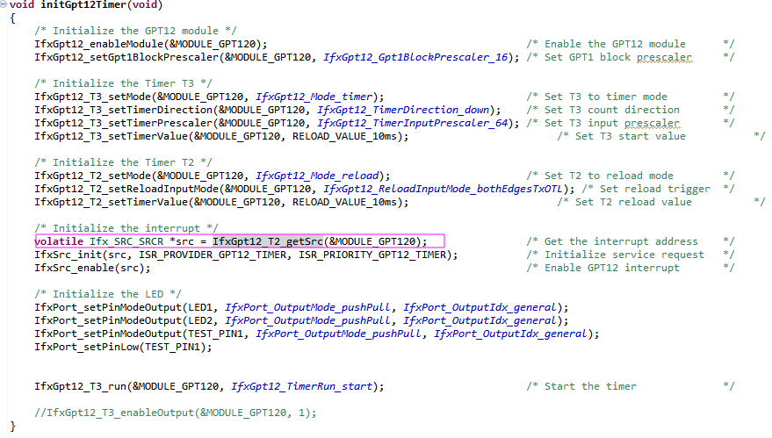
8. TC275 GPT 예제 프로그램 소스 응용
Interrupt Timer2로 변경

Slide 40
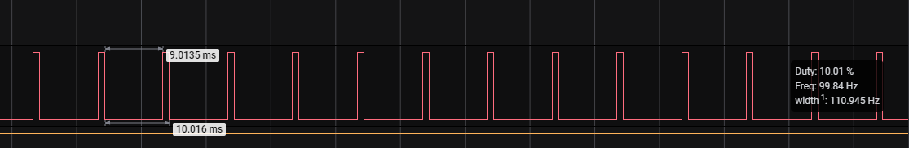
8. TC275 GPT 예제 프로그램 소스 응용
10msec의 파형 발생

Slide 41
감사합니다.

